Slide 1



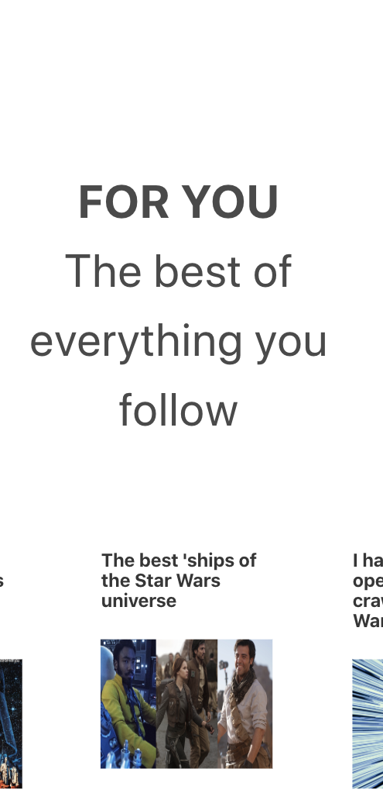
Project-1

Slide 2



TEAM
ZANE
Alejandra
Tina

Slide 3
TOPIKASe
Is a platform that allows their end users to select from different topics.
They can select between articles and videos, and also have the ability to search other topics not available on Topikas.

Slide 4
What we used
HTML
CSS
JS
Jquery
Bootstrap
Bulma
Youtube API
News API

Slide 5
Mockups

Slide 6

HOME PAGE

Slide 7
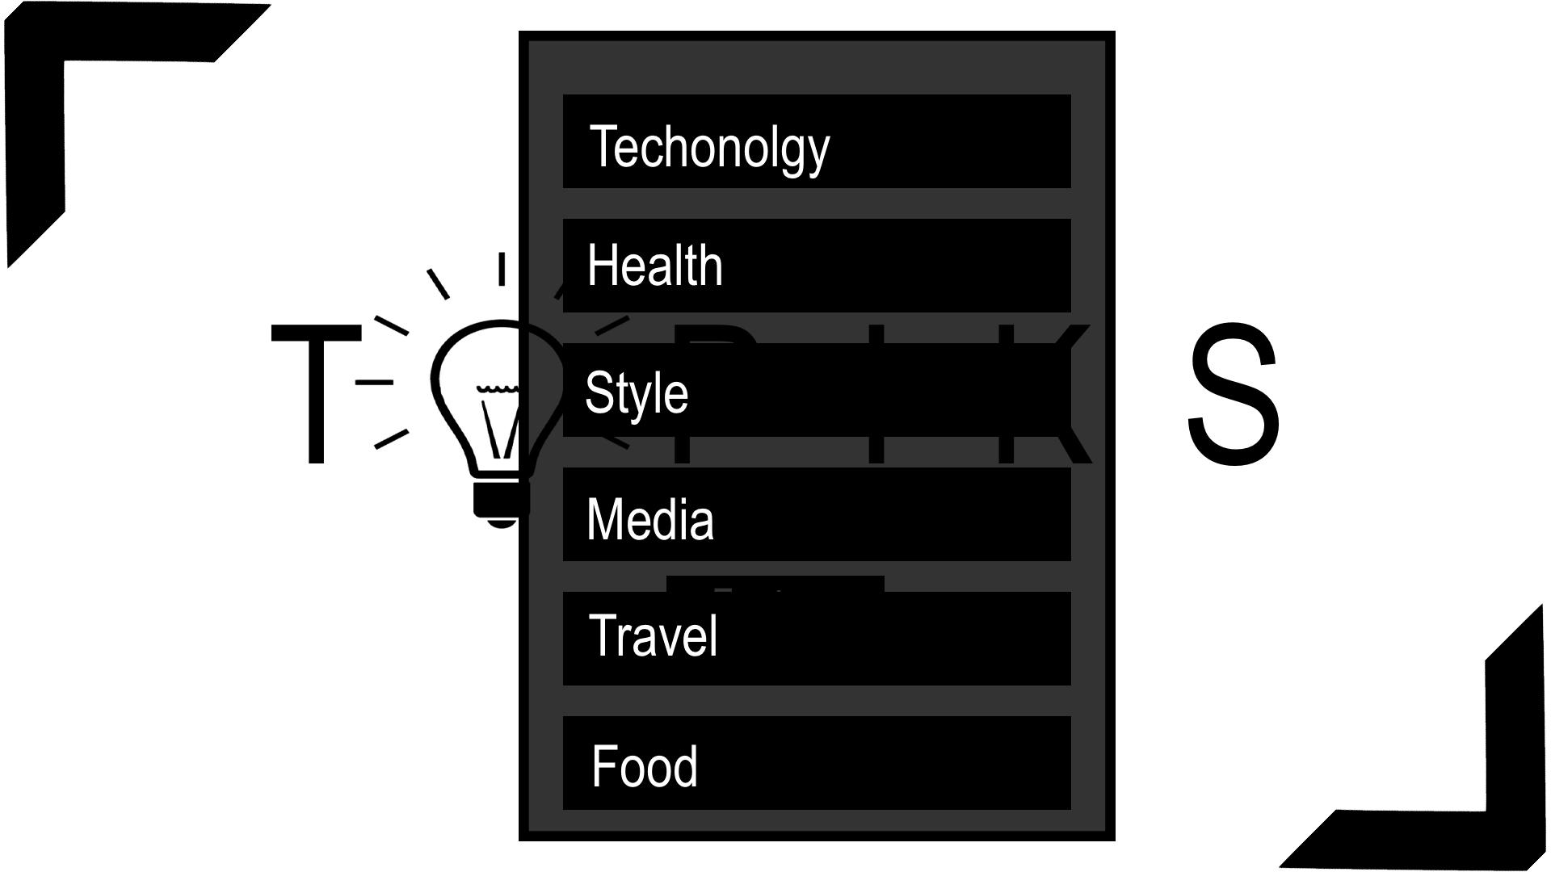
DROP DOWN MENU

Slide 8
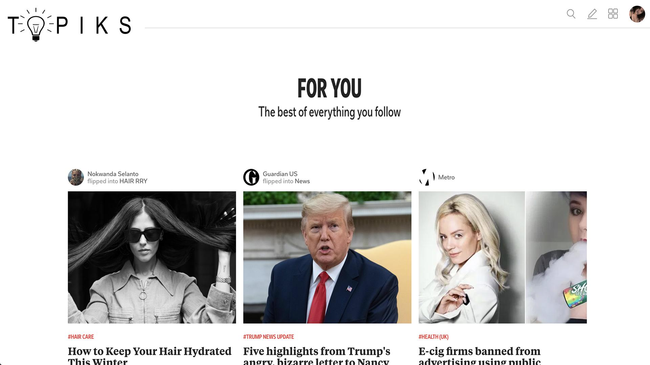
LANDING PAGE

Slide 9
Final Look

Slide 10

TOPIKS

Slide 11
Questions?

